Slide 1
IEEEXtreme Countdown
IEEEXtreme 10.0 και 11.0

Slide 2
What is IEEE?
Institute of Electrical and Electronics Engineers
The largest technical professional organization in the world
It has over 420,000 members in 160 countries
IEEE Greece Section has over 2000 members

Slide 3
IEEE IHU Student Branch
Serres Campus
Founded: 2011
(As IEEE TEI of Serres Student Branch)
Rebranded (No1): 2013
(As IEEE TEI of Central Macedonia Student Branch)
Rebranded (No2): 2019
(As IEEE IHU Student Branch – Serres)

Slide 4
IEEE IHU Student Branch
Serres Campus
Awards
IEEE Regional Exemplary Student Branch Award 2019
IEEE Regional Exemplary Student Branch Award 2020
2nd Place - Better Life Challenge 2020 by Kotsovolos
As Cross-SB Team
IEEE IHU RAS Student Branch Chapter
IEEE UTh Student Branch - Volos
IEEE Regional Exemplary Student Branch Award 2021

Slide 5
IEEE Links
IEEE Global – Greece – IHU Serres
https://ieee.org
https://ieee.gr
https://ieeeihuserres.org

Slide 6

Presenter
Who???
Iordanis Kostelidis
Software Engineer @DataScouting
BEng in Informatics
Software Engineering
Graduate Student
MSc in Robotics
Member of IEEE / IEEE Young Professionals
Interim Chair of IEEE IHU Student Branch - Serres
IEEEXtreme 18.0 Ambassador
IEEEXtreme 18.0 Proctor of IEEE IHU Student Branch - Serres

Slide 7
CSAcademy
The Coding Platform
Live Demo
General: https://csacademy.com
IEEEXtreme Practice: https://csacademy.com/ieeextreme-practice/

Slide 8
Painter's Dilemma
IEEEXtreme 10.0
https://csacademy.com/ieeextreme-practice/task/painters-dilemma/
Bob just got his first job as a house painter. Today, on his first day on the job, he has to paint a number of walls.
For those of you that have done some house painting before, you know that this is no easy task. Each wall has to be painted in multiple rounds, possibly with a different color of paint each time, and there needs to be sufficient time of waiting between consecutive rounds for the paint to dry.
To make optimal use of their time, house painters usually paint walls while waiting for other walls to dry, and hence interleave the rounds of painting different walls. But this also brings up another challenge for the painters: different walls may require different colors of paint, so they might have to replace the color on one of their paint brushes before painting that wall. But this requires washing the paint brush, waiting for it to dry, and then applying the new paint to the brush, all of which takes precious time.

Slide 9
Painter's Dilemma
IEEEXtreme 10.0
The more experienced house painters circumvent the issue by bringing a lot of paint brushes. But Bob is not that fortunate, and only has two paint brushes!
Given a sequence of colors c1​,c2​,...,cN​ that Bob needs, in the order that he needs them, can you help him determine the minimum number of times he needs to change the color of one of his brushes? Both of his brushes will have no color to begin with.
Bob may ask you to compute this number for a few different scenarios, but not many. After all, he only needs to do this until he gets his first paycheck, at which point all his effort will have been worth the trouble, and he can go buy more paint brushes.

Slide 10
Painter's Dilemma
IEEEXtreme 10.0
Standard input
The first line of input contains t, which gives the number of scenarios.
Each scenario consists of two lines. The first line contains an integer NN, the length of the sequence of colors Bob needs. The second line contains a sequence of NN integers c1​,c2​,...,cN​, representing the sequence of colors that Bob needs, in the order that he needs them. Each distinct color is represented with a distinct integer.

Slide 11
Painter's Dilemma
IEEEXtreme 10.0
Standard output
For each scenario, you should output, on a line by itself, the minimum number of times Bob needs to change the color of one of his brushes.

Slide 12
Painter's Dilemma
IEEEXtreme 10.0
Constraints and notes
1 ≤ t ≤ 5
1 ≤ N ≤ 500
1 ≤ ci ≤ 20

Slide 13
Painter's Dilemma
IEEEXtreme 10.0
Summary of Input/Output
Input:
TestCases, integer: test cases
ColorLenght, integer: colors length
Colors, list: colors
Output:
For each test case:
Switches, integer: the minimum color changes of brushes

Slide 14
Painter's Dilemma
IEEEXtreme 10.0
Example Input/Output
Input:
2
5
7 7 2 11 7
10
9 1 7 6 9 9 8 7 6 7
Output:
3
6

Slide 15
Painter's Dilemma
IEEEXtreme 10.0
The Solution
At the start, both brushes are clean (color = 0)
We see the color (Ccurrent) we want to use
If first brush equals 0, we use it
If first brush equals Ccurrent, we use it
If second brush equals 0, we use it
If second brush equals Ccurrent, we use it
Calculate the occurrence distance of each brush color
If first brush distance is lower that second brush distance
Use second brush
Else
Use first brush

Slide 16
Painter's Dilemma
IEEEXtreme 10.0
Live Code
https://github.com/IordanisKostelidis/painters-dilemma

Slide 17

Painter's Dilemma
IEEEXtreme 10.0

Slide 18
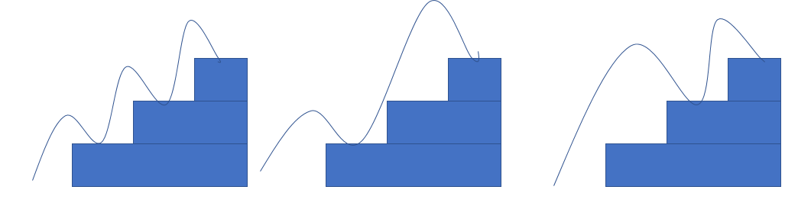
Running Up Stairs
IEEEXtreme 11.0
Every 12-year-old boy (at least in America) feels the need to run up the stairs skipping some of them. For this problem, we are going to assume that he randomly skips single steps. (with each step of his foot, he may land on the next step or he may skip one step and land on the following step). For example, if there are three steps, he could traverse them three ways:

Slide 19
Running Up Stairs
IEEEXtreme 11.0
The challenge in this problem is: given a number of stairs, calculate the number of ways he could traverse them.

Slide 20
Running Up Stairs
IEEEXtreme 11.0
Standard input
The input will start with a single line containing one integer t (1≤t≤5) specifying the number of instances of the problem. Each subsequent line will contain one instance of the problem – a single integer n (1≤n≤22000) specifying the number of steps in the stair case.

Slide 21
Running Up Stairs
IEEEXtreme 11.0
Standard output
For each instance of the problem, your program must output one line containing a single integer – the number of ways the steps could be traversed.

Slide 22
Running Up Stairs
IEEEXtreme 11.0
Constraints and notes
1 ≤ t ≤ 5
1 ≤ n ≤ 22000

Slide 23
Running Up Stairs
IEEEXtreme 11.0
Summary of Input/Output
Input:
TestCases, integer: test cases
Steps, integer: steps of stair case
Output:
For each test case:
Ways, integer: the number of ways the steps could be traversed

Slide 24
Running Up Stairs
IEEEXtreme 11.0
Example Input/Output
Input:
1
3
Output:
3

Slide 25
Running Up Stairs
IEEEXtreme 11.0
Solution – Part 1
If solution is s(n)
For n=3(+1, the current step), s(n) = s(n-1) + s(n-2), oooohh wait…., this is…..

Slide 26
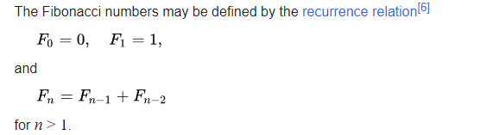
Running Up Stairs
IEEEXtreme 11.0
Wikipedia
Solution – Part 1
Fibonacci sequence

Slide 27
Running Up Stairs
IEEEXtreme 11.0
Solution – Part 1
Table:
s(0) = 0
s(1) = 1
s(2) = s(1) + s(0) = 1 + 0 = 1
s(3) = s(2) + s(1) = 1 + 1 = 2
s(3+1) = s(4) = s(3) + s(2) = 2 + 1 = 3

Slide 28
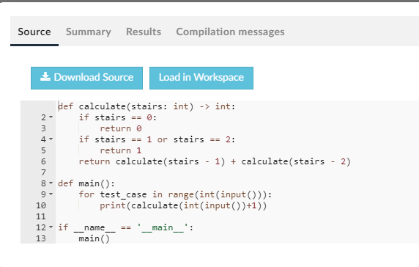
Running Up Stairs
IEEEXtreme 11.0

Slide 29
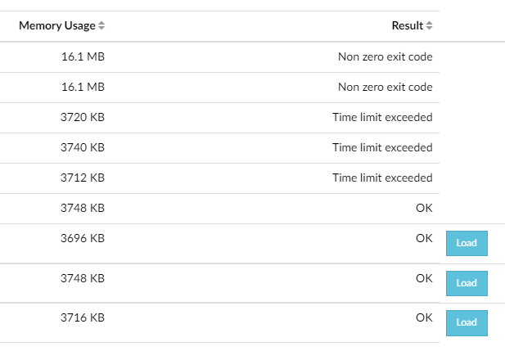

Running Up Stairs
IEEEXtreme 11.0
😭

Slide 30
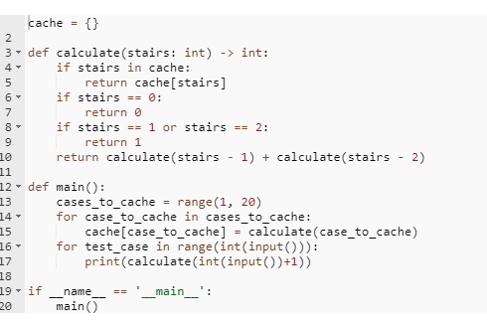
Running Up Stairs
IEEEXtreme 11.0
Solution – Part 2
It’s cache time ☺

Slide 31
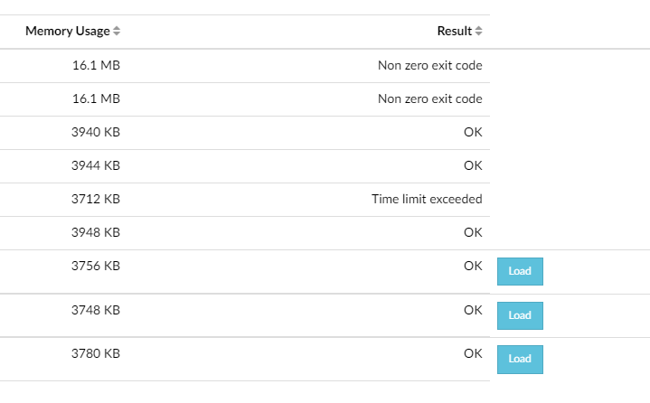

Running Up Stairs
IEEEXtreme 11.0
😭

Slide 32
Running Up Stairs
Powered by ChatGPT
“why for loops are better that recursive for Fibonacci?”
IEEEXtreme 11.0
Solution – Part 3
We must OPTIMIZE it
Efficiency:
Recursive Fibonacci has exponential time complexity O(2^n).
For loop runs in linear time O(n).
Memory Usage:
Recursion can lead to high memory use and stack overflow.
For loop maintains constant space complexity O(1).
Simplicity:
Iterative solutions are often more straightforward.
Easier to understand for those less familiar with recursion.
Avoiding Redundant Calculations:
Iterative approach computes each value once.
Recursion can lead to many redundant calculations.

Slide 33
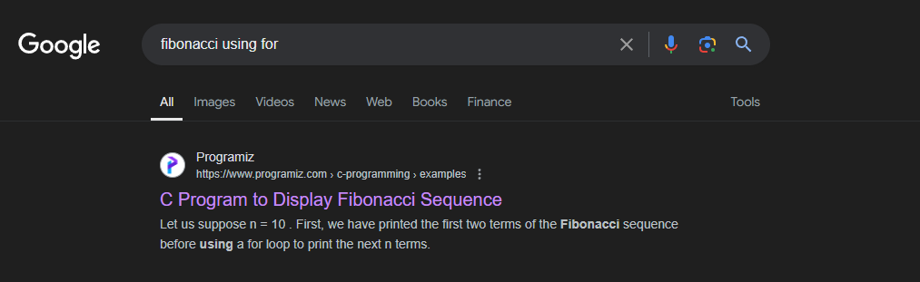
Running Up Stairs
IEEEXtreme 11.0
Solution – Part 3
It’s googling time

Slide 34
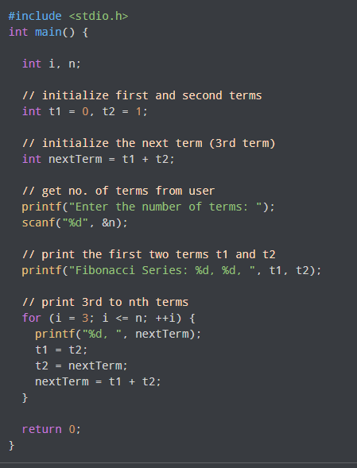
Running Up Stairs
IEEEXtreme 11.0
Solution – Part 3

Slide 35
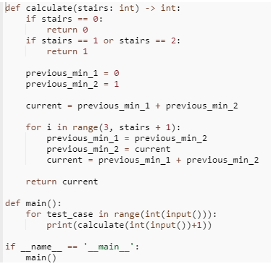
Running Up Stairs
IEEEXtreme 11.0

Slide 36
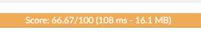
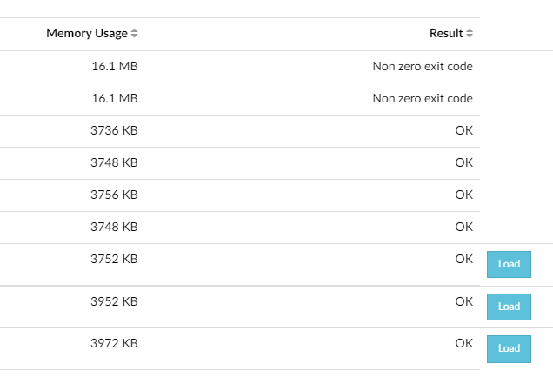
Running Up Stairs
IEEEXtreme 11.0
😭

Slide 37
Running Up Stairs
IEEEXtreme 11.0
Solution
Why??
Hint: Constraints and notes

Slide 38
Running Up Stairs
IEEEXtreme 11.0
Constraints and notes
1 ≤ t ≤ 5
1 ≤ n ≤ 22000

Slide 39
Running Up Stairs
IEEEXtreme 11.0
Solution
Why??
Hint: Constraints and notes
Let’s check, the result for Steps=22000

Slide 40
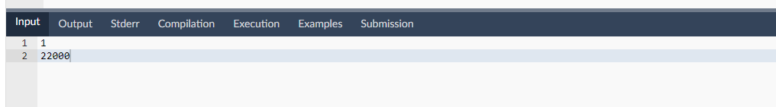
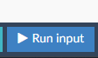
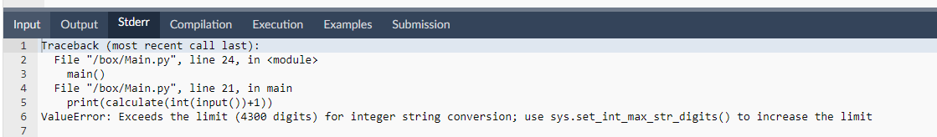
Running Up Stairs
IEEEXtreme 11.0

Slide 41
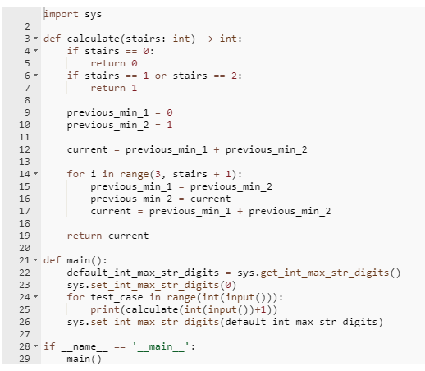
Running Up Stairs
IEEEXtreme 11.0
Solution

Slide 42

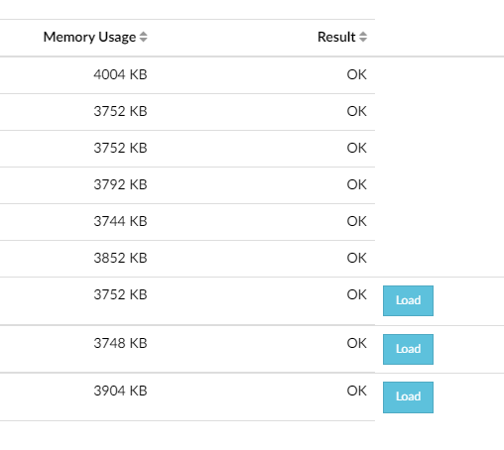
Running Up Stairs
IEEEXtreme 11.0
🎉🥳🎉

Slide 43
Running Up Stairs
IEEEXtreme 11.0
Live Code
https://github.com/IordanisKostelidis/running-up-stairs

Slide 44
Running Up Stairs
IEEEXtreme 11.0

Slide 45
IEEEXtreme Countdown
Links:
Code and Presentations:
https://github.com/VaggM/IEEEXtremeCountdown
IEEE: https://ieee.org
IEEE Greece Section: https://ieee.gr
IEEEXtreme: https://ieeextreme.org

